Slide 1
DATA ANALYSIS
Sefam Agbenyega

Slide 2
What is data analysis?
Data analysis is the process of inspecting, cleansing, transforming, and modelling data with the goal of discovering useful information, informing conclusions, and supporting decision-making.
The procedure helps reduce the risks inherent in decision-making by providing useful insights and statistics, often presented in charts, images, tables, and graphs.

Slide 3
Uses of data analysis

Slide 4
Uses of data analysis
Data analysis has numerous practical uses across various fields. Here are a few examples:
Science and Research
Business and Marketing
Healthcare and Medicine
Finance and Economics

Slide 5
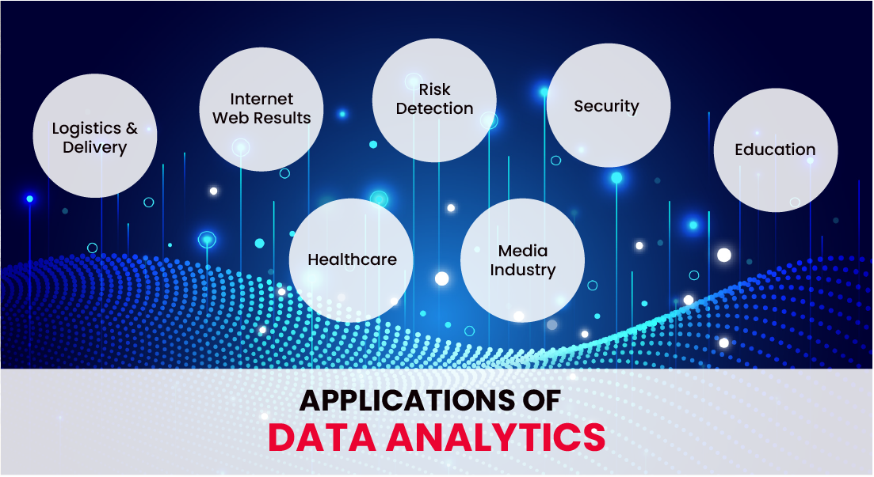

Slide 6
types of data analysis

Slide 7
TYPES of data analysis
Several types of data analysis techniques exist based on business and technology. However, the major data analysis methods are:
Text Analysis
Statistical Analysis
Diagnostic Analysis
Predictive Analysis
Prescriptive Analysis

Slide 8
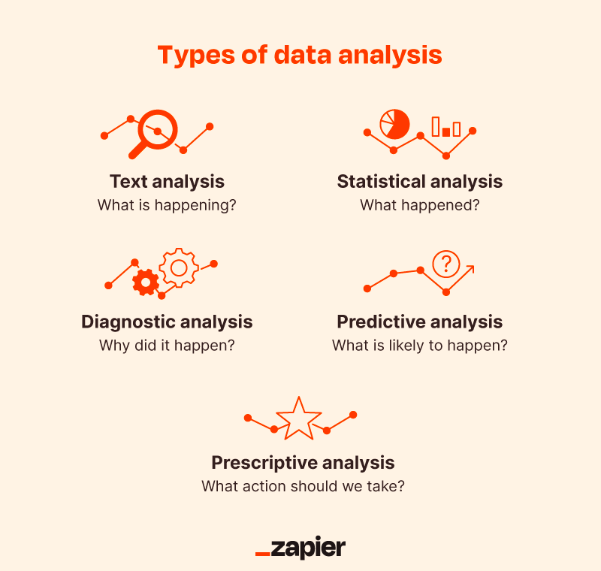

Slide 9
importance of data analysis

Slide 10
importance of data analysis
Here is a list of reasons why data analysis is crucial to doing business today.
Better Customer Targeting
You Will Know Your Target Customers Better
Reduce Operational Costs
Better Problem-Solving Methods

Slide 11
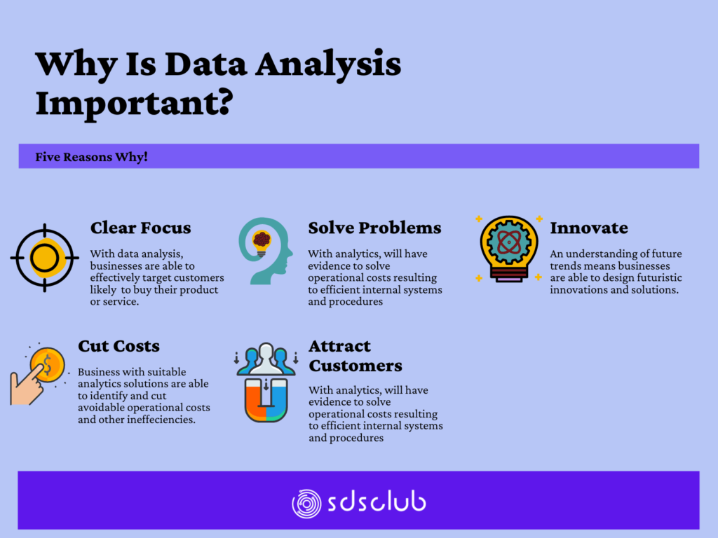

Slide 12
EXAMPLES

Slide 13
EXAMPLES OF DATA ANALYSIS
Here are a few examples of data analysis in different domains:
Sales Analysis: A company wants to analyze its sales data to identify patterns and trends. They examine factors like sales volume, revenue, customer demographics, and product performance. This analysis helps them understand which products are selling well, identify customer preferences, and make informed decisions on pricing, promotions, and inventory management.

Slide 14
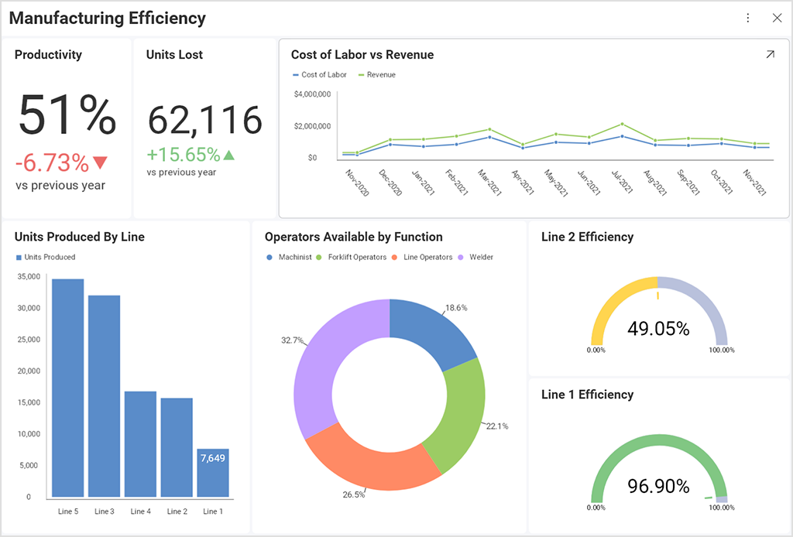
Manufacturing Efficiency In a Company.

Slide 15
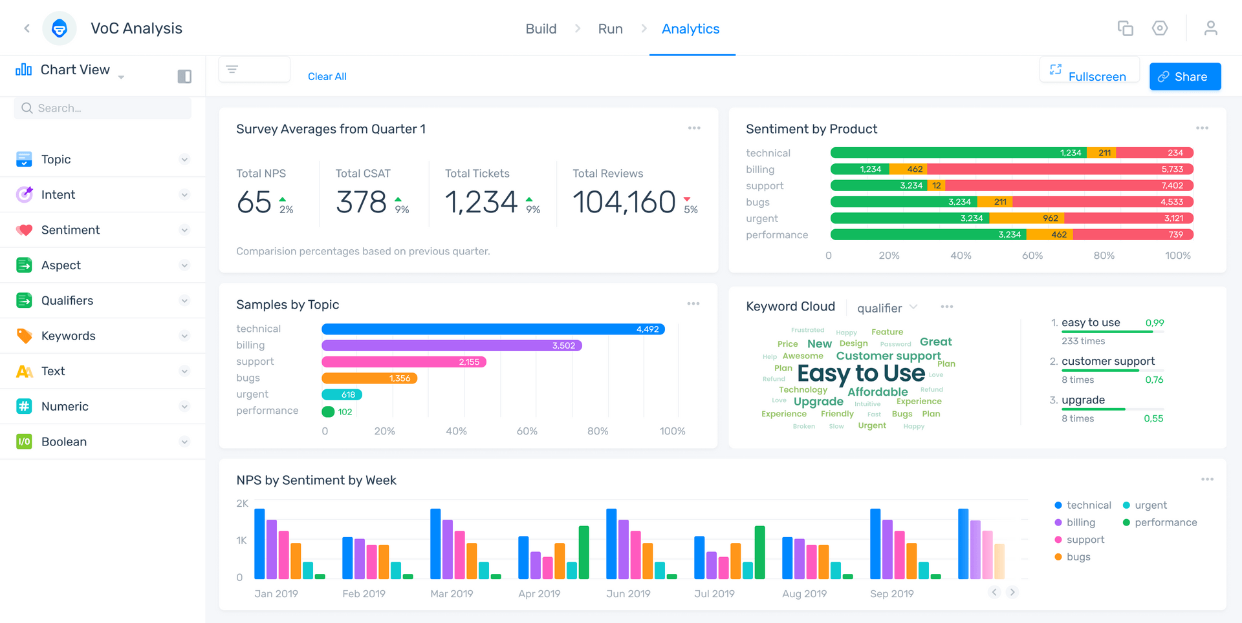
Data Analysis In Different Forms

Slide 16
SUMMARY
Data analysis is a powerful tool that helps us understand the world better, make informed decisions, and uncover interesting insights. It's used in various fields, such as science, business, and even sports. By analyzing data, we can discover patterns, make predictions, and learn new things about the world around us.

Slide 17
THANK YOU
By:
Sefam Agbenyega

